Slide 1

Quantum processors and computing.
Aliyeva Qumru

Slide 2
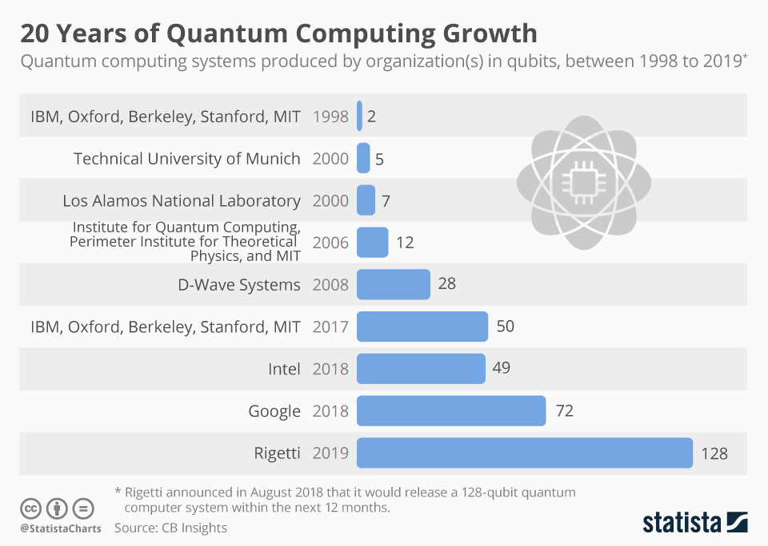
What is quantum computing?
Quantum computing is a rapidly developing technology that uses the laws of quantum mechanics to solve problems too complex for classical computers. Today, IBM Quantum makes real quantum hardware -- a tool scientists only began to imagine three decades ago -- available to thousands of developers. Our engineers deliver ever-more-powerful superconducting quantum processors at regular intervals, building toward the quantum computing speed and capacity necessary to change the world. These machines are very different from the classical computers that have been around for more than half a century.

Slide 3
Why do we need quantum computers?
For some problems, supercomputers aren’t that super.
When scientists and engineers encounter difficult problems, they turn to supercomputers. These are very large classical computers, often with thousands of classical CPU and GPU cores.
If a supercomputer gets stumped, that's probably because the big classical machine was asked to solve a problem with a high degree of complexity. When classical computers fail, it's often due to complexity.

Slide 4
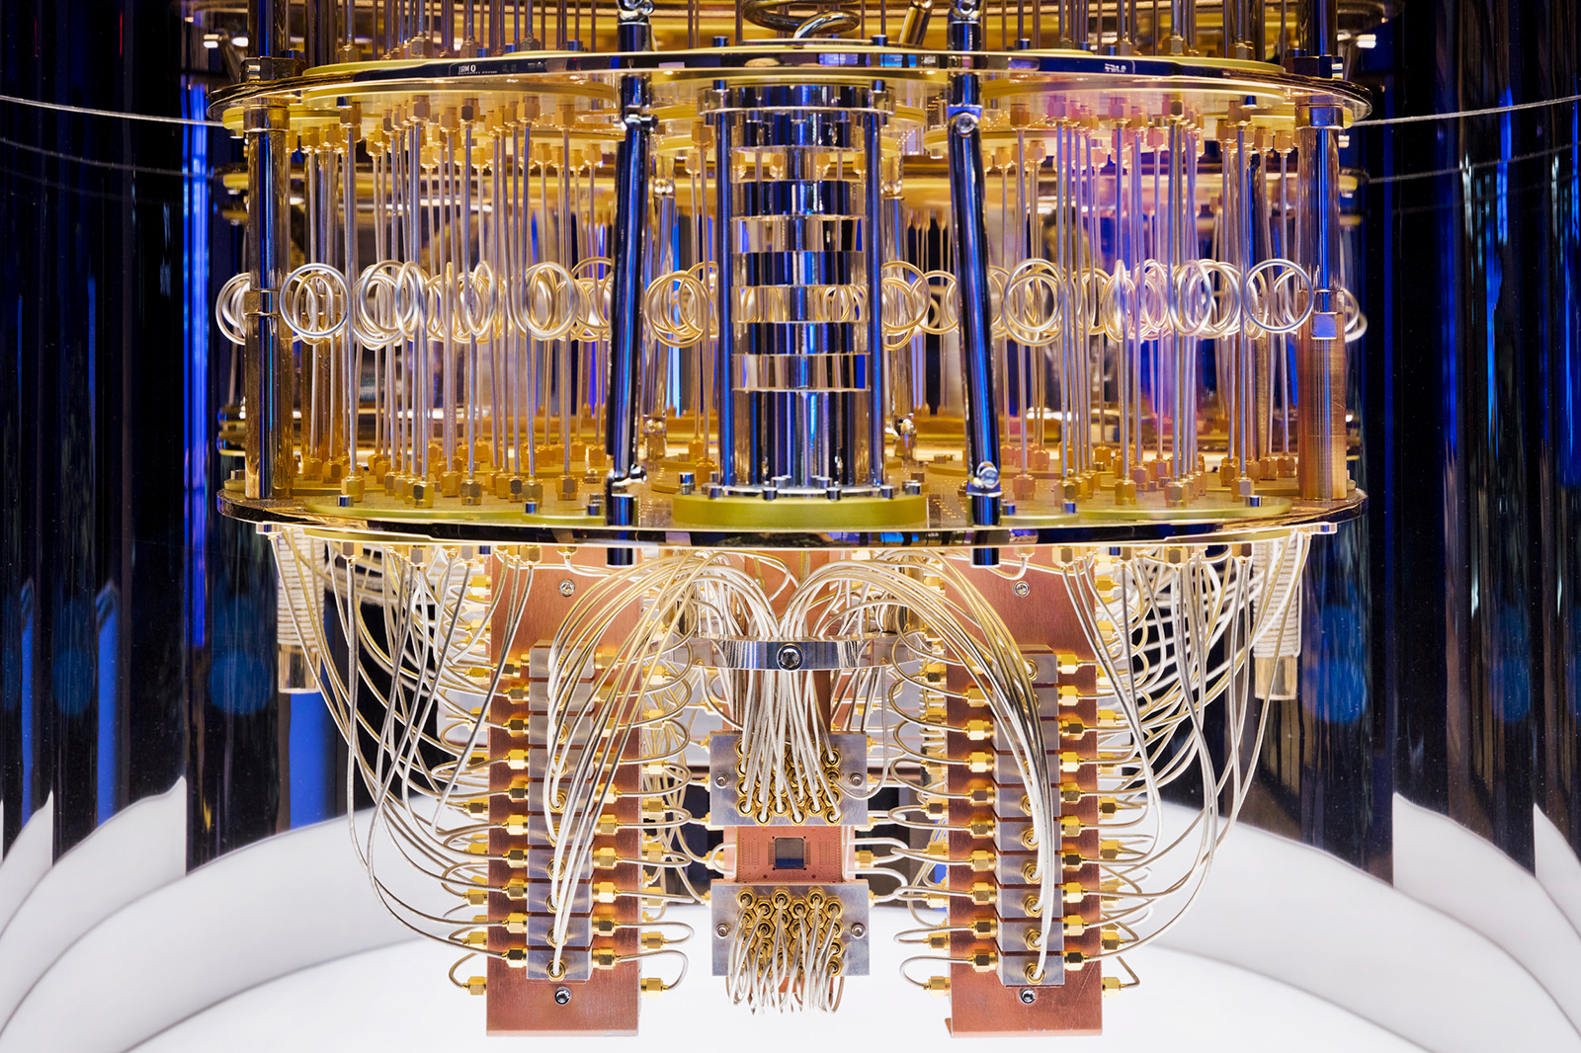
Quantum computing
Quantum computing uses a combination of bits to perform specific computational tasks. All at a much higher efficiency than their classical counterparts. A quantum computer gets most of its processing power from bits in multiple states at once. They can perform tasks using 1, 0, and a combination of both 1 and 0 at the same time. Current research centers in quantum computing include MIT, IBM, Oxford University, and Los Alamos National Laboratory. In addition, developers have begun to gain access to quantum computers through cloud services.

Slide 5
How to solve problems with a quantum computer?
Classical computers are better at some tasks than quantum computers, such as sending and receiving emails, creating spreadsheets and other documents, and desktop publishing. Quantum computers have the potential to solve some problems better, faster, and more efficient than classical computers.
To solve any problem, you’ll have input, computation, and output.
Input – The data required to run the computation
Computation – The instructions given to the computer to process the data
Output – The useful result received from the computation

